Slide 1
FreeLoading...

Slide 2
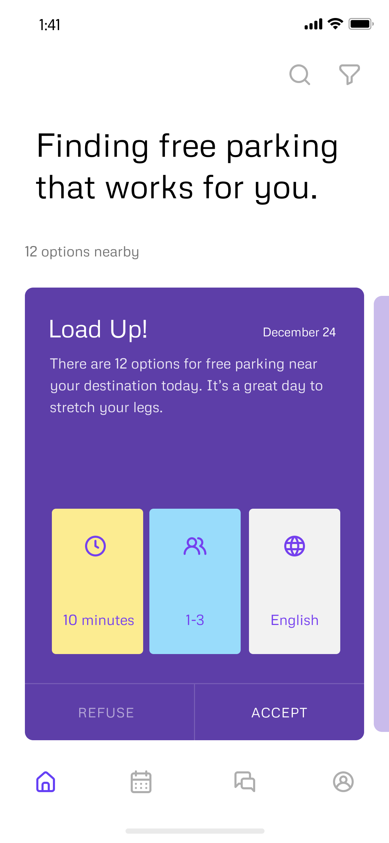
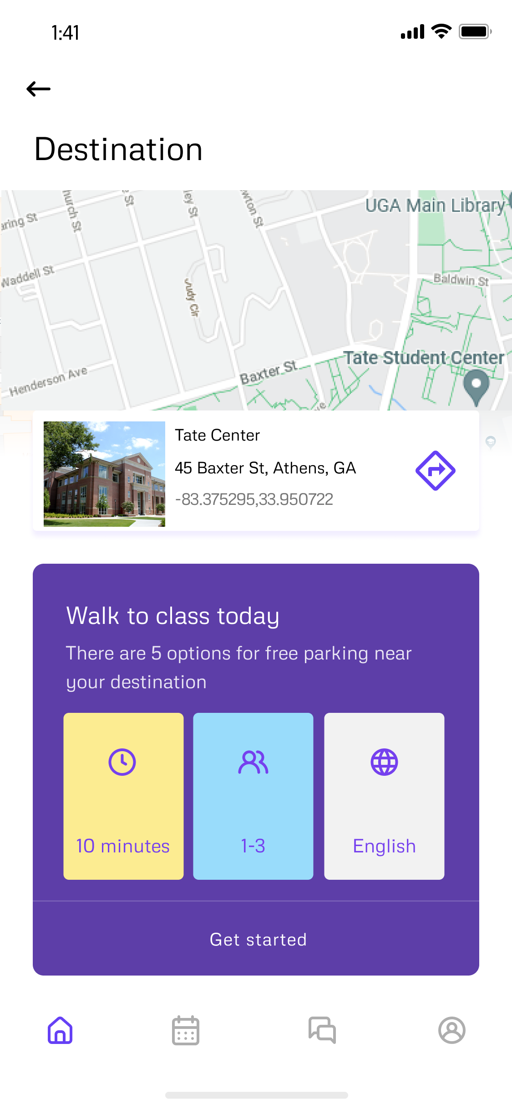
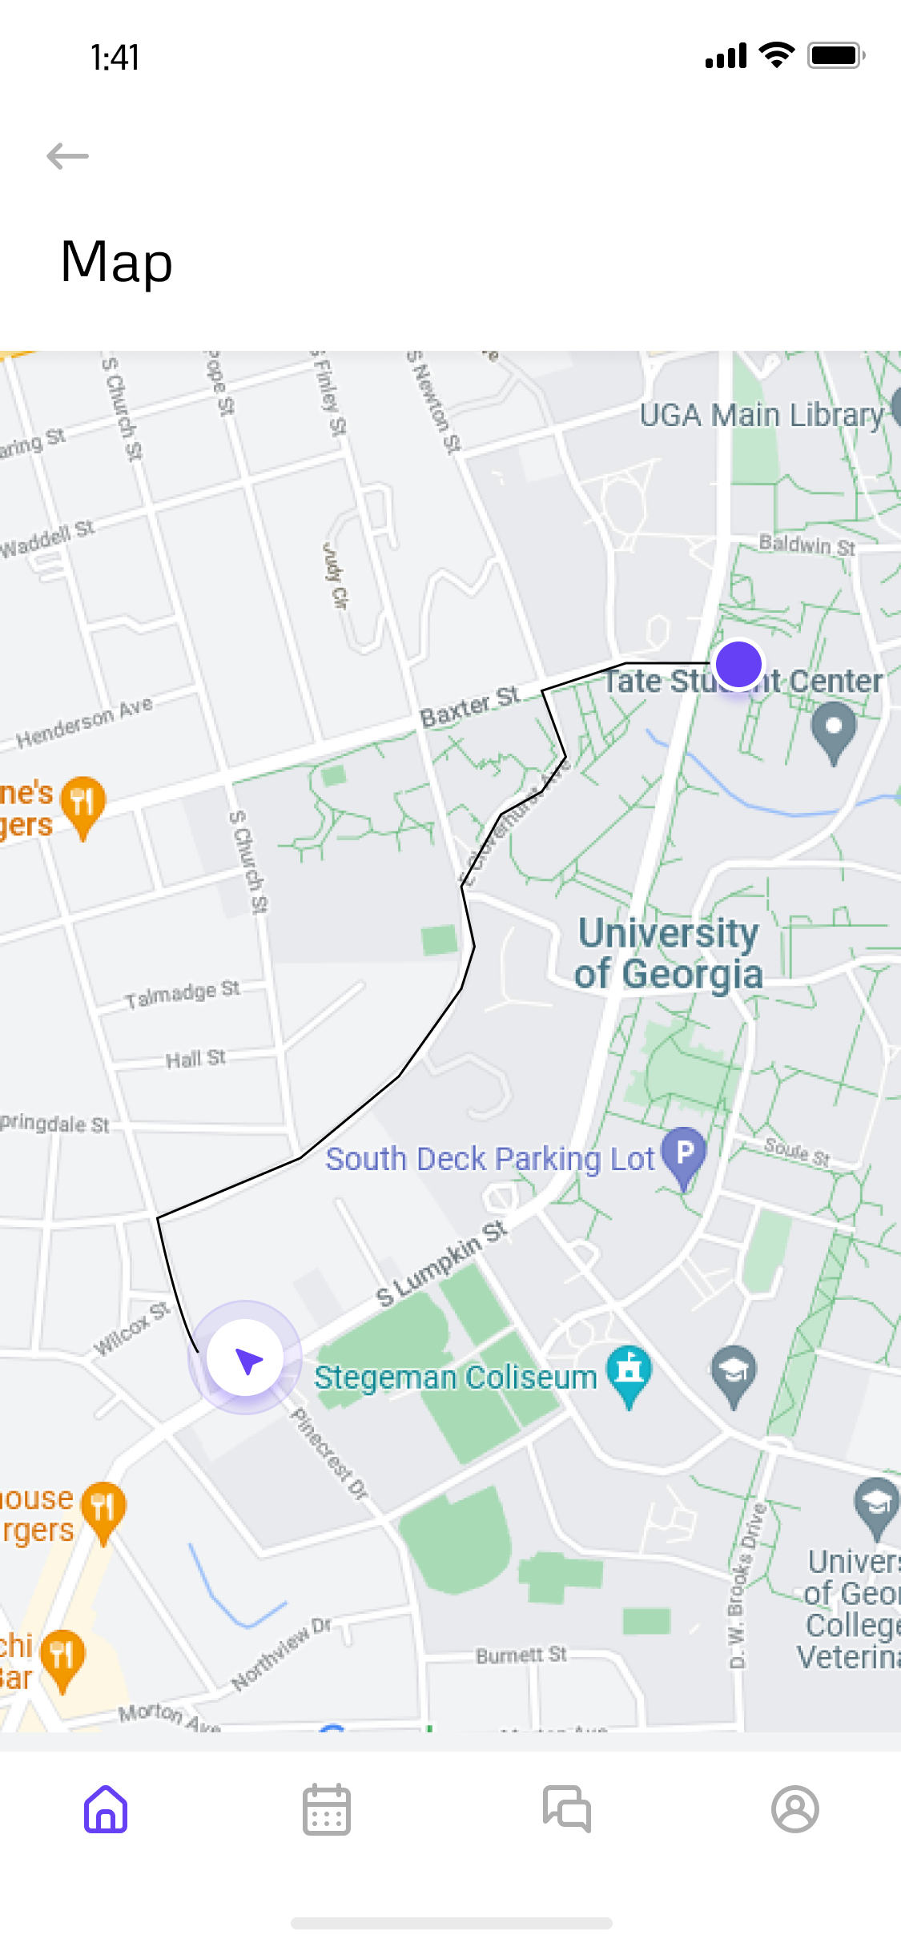
Your search is over
With FreeLoading… you’ve found your spot
Parking, instantly, for free

Slide 3
How often do you have trouble finding parking?

Slide 4
Our application allows you to find your most convenient options instantly by destination alone

Slide 5
Once selected, our application will direct you from your car to your destination

Slide 6
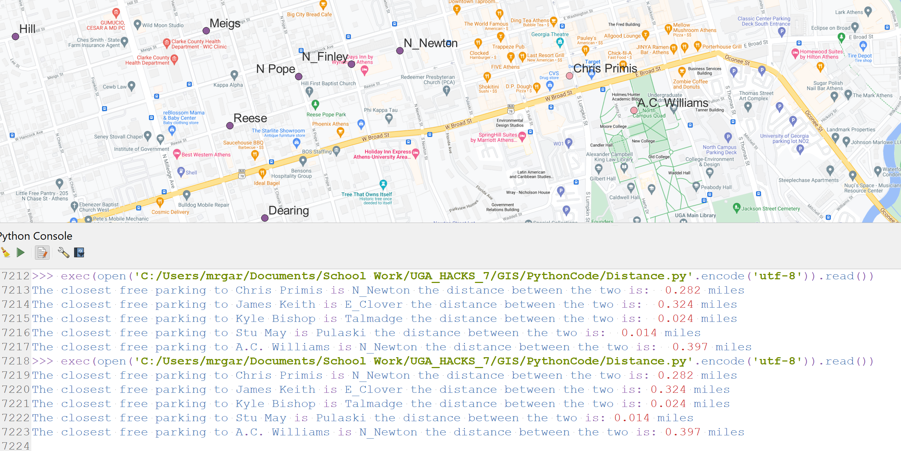
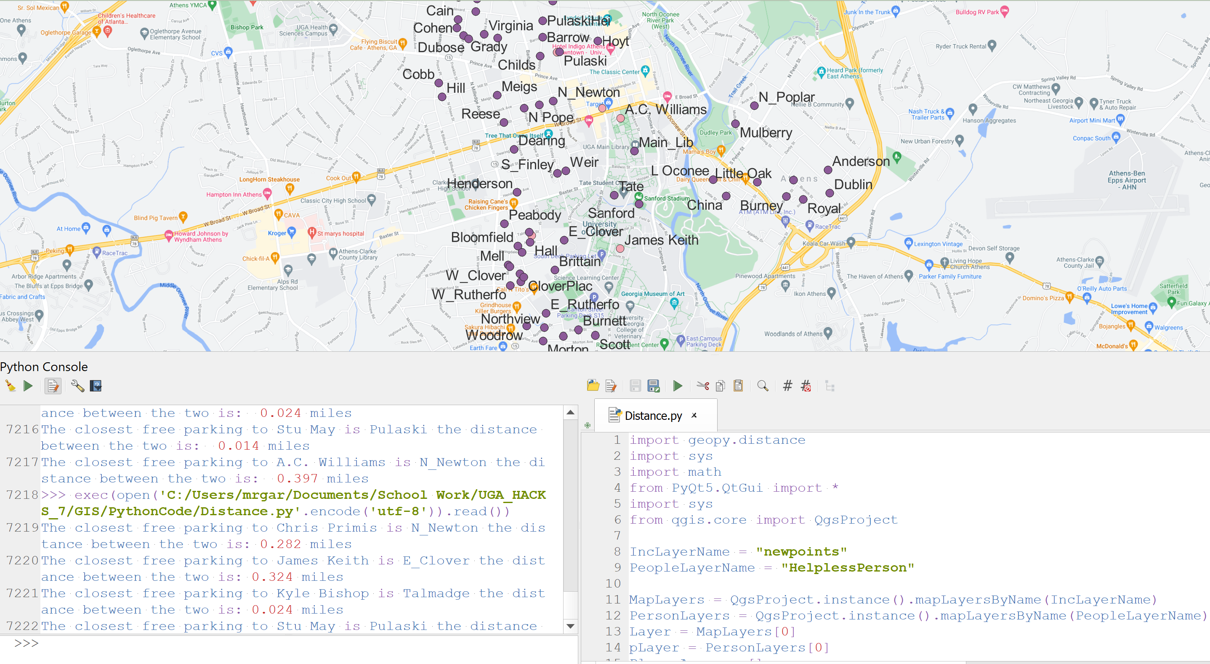
Select your destination and our application will identify your best options from an array of local streets

Slide 7
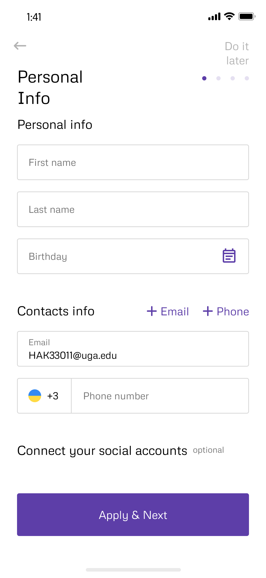
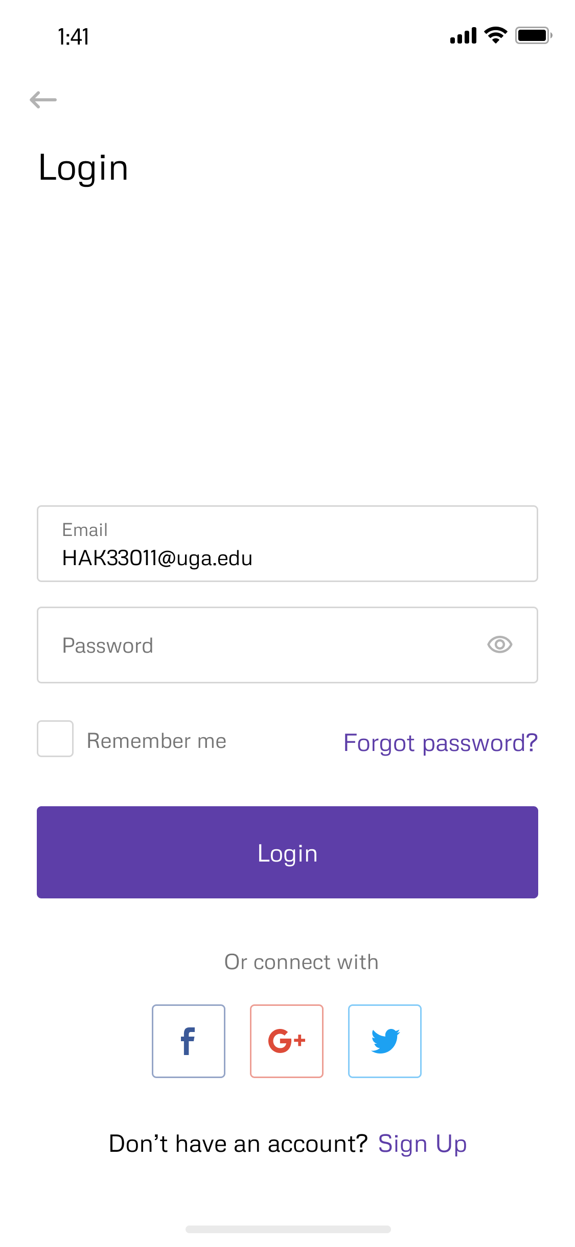
Personalizing your search for freedom
Sign up for free
Save your most common destinations and favorite spots to park
Help others find spots that work for them

Slide 8
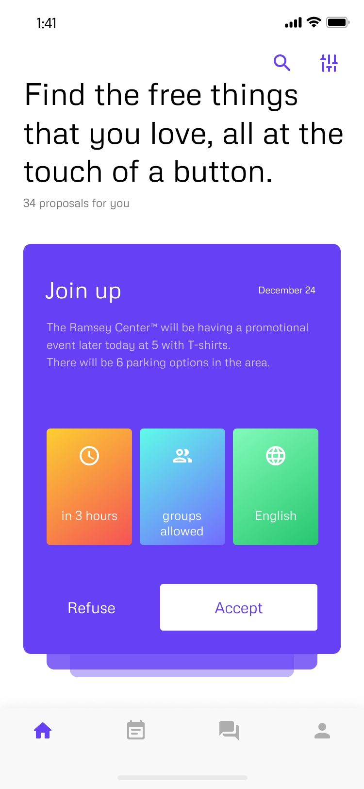
Our app doesn’t have to stop at parking, but can be extended to an array of your favorite free things

